Slide 1
SAN DIEGO HOUSING MARKET PROJECT
TEAM MEMBERS:
Wen Yan Mengting Wang Salah Ahmad Xia Song
ADVISORS:
Volkan Vural Ilkay Altintas
DATA SPONSORS:
San Diego County Matt Kissinger

Slide 2
WHO ARE WE & OUR GOAL
WE ARE A GROUP OF DATA SCIENTISTS WHO AIM AT:
Exploring San Diego Housing Market
Providing comprehensive review and methodology for potential home buyers and investors

Slide 3
WHO ARE WE & OUR GOAL
Provide guidance to short-term and long-term investors
TWO DIMENSIONS-
GEOGRAPHICAL & TRENDING (LONG AND SHORT TERMS)
Deep dive into the region for housing price estimation (similar to Zestimate)
We’re NOT providing future forecast

Slide 4
TEAM STRUCTURE
Salah- Data collection, database construction, integration and querying
Wen- Technique solutions, architecture, model evaluations and general research design
Xia- Research and modeling
Mengting- Project manager; data visualization
Introducing web interface
sdha.info:3000

Slide 5
DATA SOURCE- SUMMARY
Data Provider | Data Source | Record Count | Volume | Variety | Velocity | Access Method
County | Sales | 3,805,514 | 30MB 1983→ 2017 | Structured | Monthly | FTP/Flat Files
County | MPR-Valuation | 1,048,575 | 38MB 2017 | Structured | Monthly | FTP/Flat Files
County | Property Characteristics | 1,048,575 | 1GB Latest as of Dec 2017 | Structured | Monthly | FTP/Flat Files
County | Address Details | 1,048,575 | 186MB Latest as of Dec 2017 | Structured | Yearly | FTP/Flat Files
County | Foreclosure | 137,475 | 6MB 1986→ 2017 | Structured | Monthly | FTP/Flat Files
Sandag | School location | 1,023 | 1MB | Geographic | One time | Web/shapefile
Great School | School Rating | ~2,000 | 1MB | Structured | Yearly | FTP/Flat Files
Sandag | Zips Boundary | 113 | 4.5 MB | Geographic | One time | Web/shape file

Slide 6
DATA SOURCE, COLLECTION & PIPELINE
Sources
Data Repository
Destination
Sales Data
Yearly
Data Dumps in csv formats
BI Tools
(i.e. Tableau)
Characteristics Data
Monthly
Staging Database
(Relational)
Data transformed into tables from files as is
Data Warehouse
Consolidated Schema
SQL
SQL
SQL
SQL
BI Tools
(i.e. Tableau)
Valuation Data
Monthly
ETL
ETL
ETL
Address
Monthly
Data imported as is. No cleansing, no processing
Data Cleansing:
De-Dup
Matching
Structure
Format
Features Engineering
Data Processing:
Validate and Apply Ranges
Outliers
Foreclosure
Monthly
School/School Rating
Yearly

Slide 7
DATA PROCESSING
Data Quality Issues
Content/Data Types
Structure
Formatting
Missing values
Data Pre-processing:
Source → Staging → Engineering → Integrated Schema → Query → Data Dump
Features Selection
Intuition
Experts Feedback
Trial and Error
Engineering
Data Transformation
Cleansing
Formatting
Finding
Matching
Modeling/Reconstructing
Querying and Optimization

Slide 8
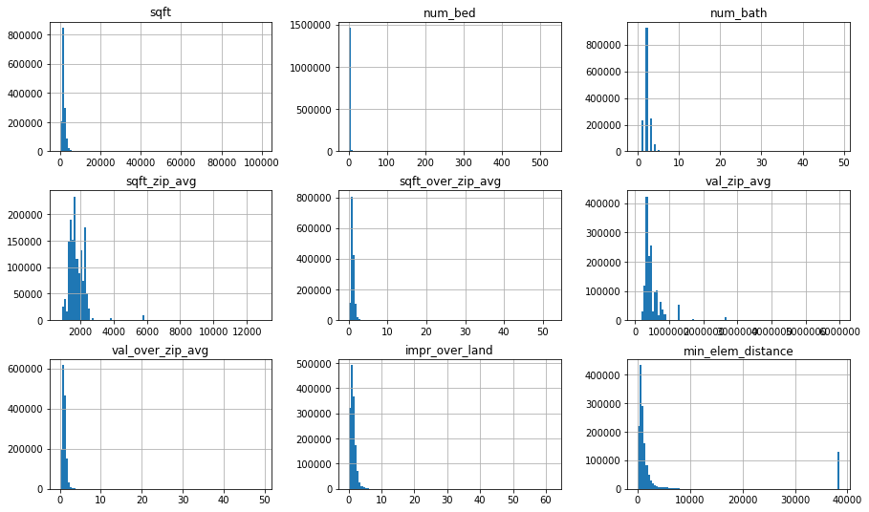
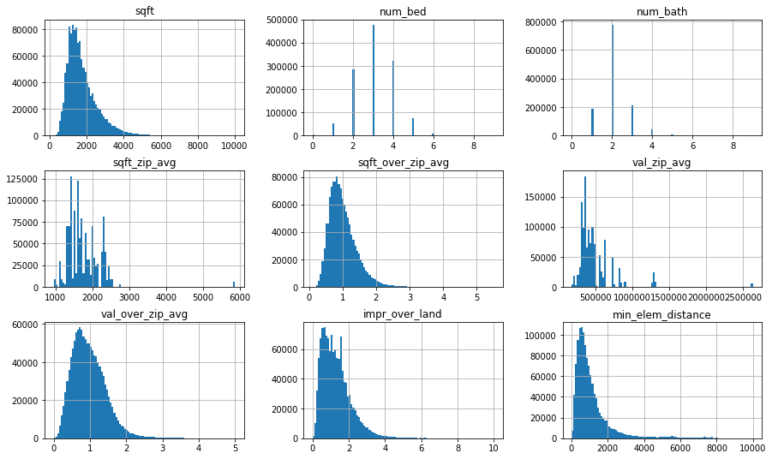
FEATURE DISTRIBUTION

Slide 9
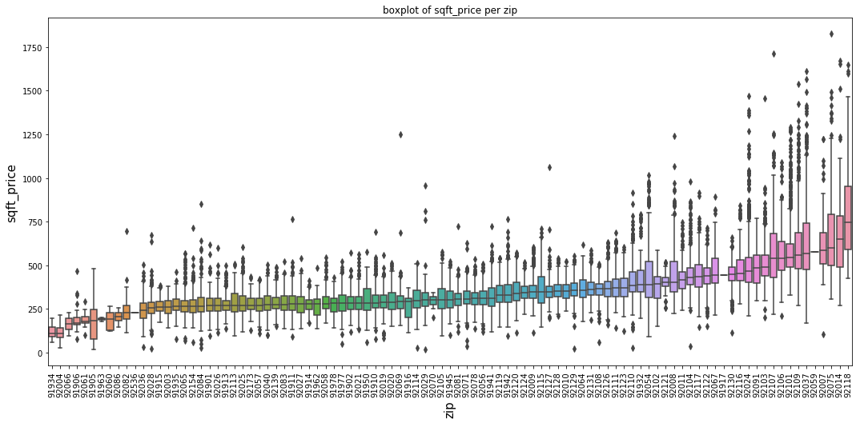
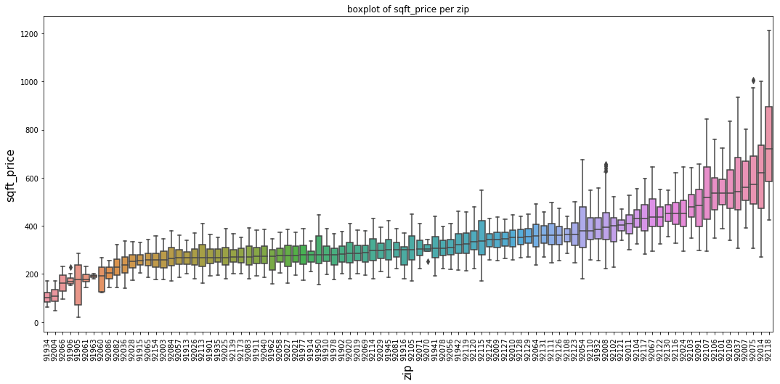
OUTLIER PER ZIPCODE

Slide 10
DATA – HIGHLIGHT FOR MAIN FEATURES
Property Characteristics:
PIN
Bedrooms
Bathrooms
Square foot
View
Pool
Sales:
PIN
Date
Sold Price
MPR-Valuation:
PIN
Land
Improvement
Address Details:
PIN
Add1
Add2
City
Zip
School Location:
SchoolName
ZipCode
Longitude
Latitude
School Rating:
School Name
Zip
Rating
Foreclosure:
PIN
Date
Original
Intermediary
Zip Average Features:
Zip Ave Sqt Foot
Zip Ave Sold Price
Valuation Zip Avg
Value over Zip Avg
Sqt Foot Over Zip Avg
School Distance
Geocoding for Longitude Latitude
Min, Max and Average school distance and rating
Engineered

Slide 11
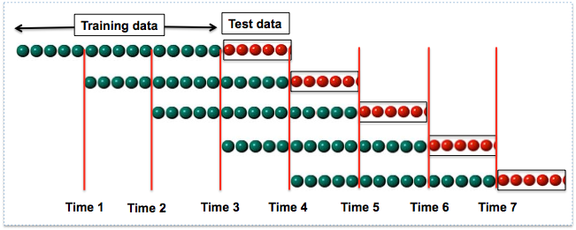
MODEL & VALIDATION

Slide 12
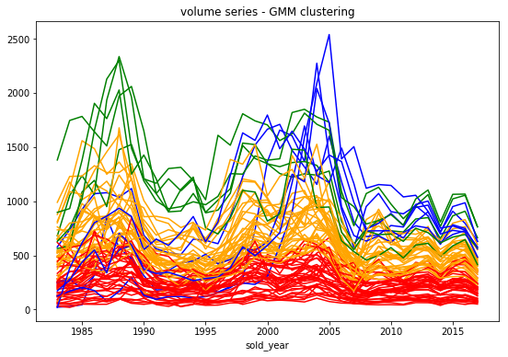
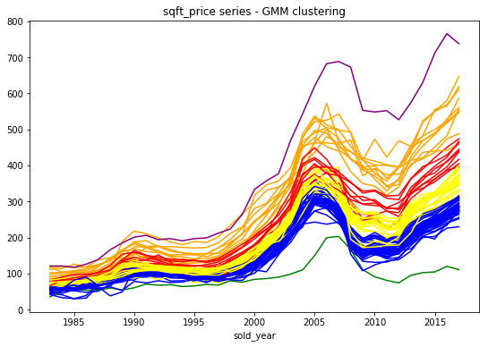
CLUSTERING

Slide 13
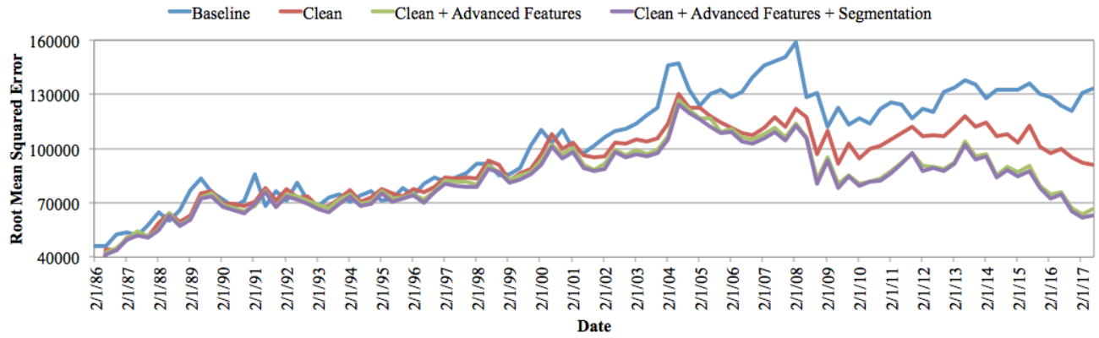
MODEL PERFORMANCE COMPARISON

Slide 14

SOLUTION ARCHITECTURE

Slide 15
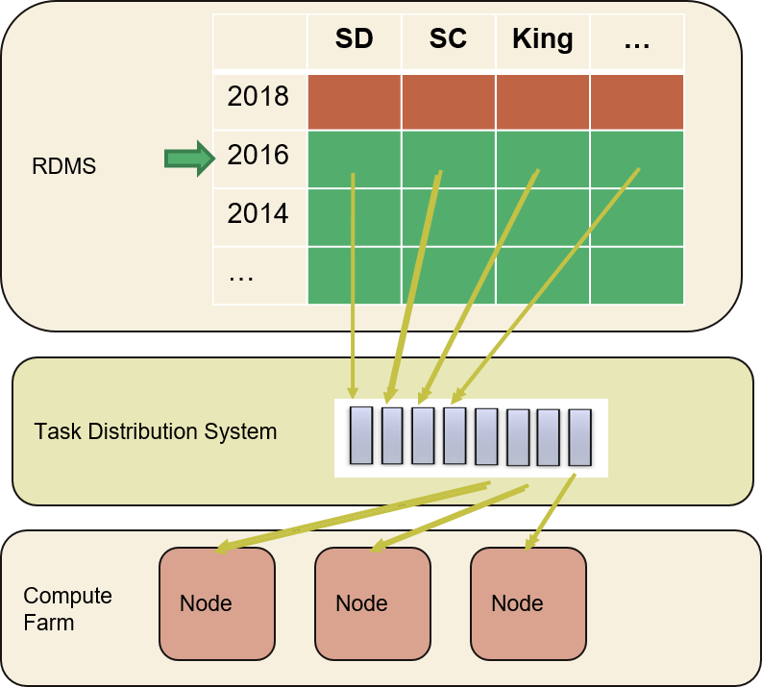




SCALABILITY
Storage: 16TB, aurora 64TB
IO: 1,000 to 30,000 IOPS, 256 KB/IO
CPU/MEM: 64 vCPU, 488 GB

Slide 16
DEMO
sdha.info:3000

Slide 17
CONCLUSION
Open-question project with modeling and heavy in engineering
Provided housing price estimation
Developed user friendly prototype application with unique features
Interesting findings through advanced EDA and modeling
Quick gain investment in smaller houses vs. safer long term investment in larger houses
Certain areas identified as safer investment during crisis
Seasonality

Slide 18
THANK YOU

